Slide 1


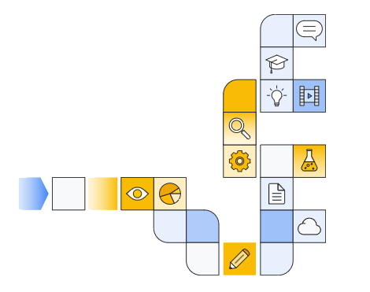

Notes:
https://www.cloudskillsboost.google/paths/183/course_templates/542/

Slide 2
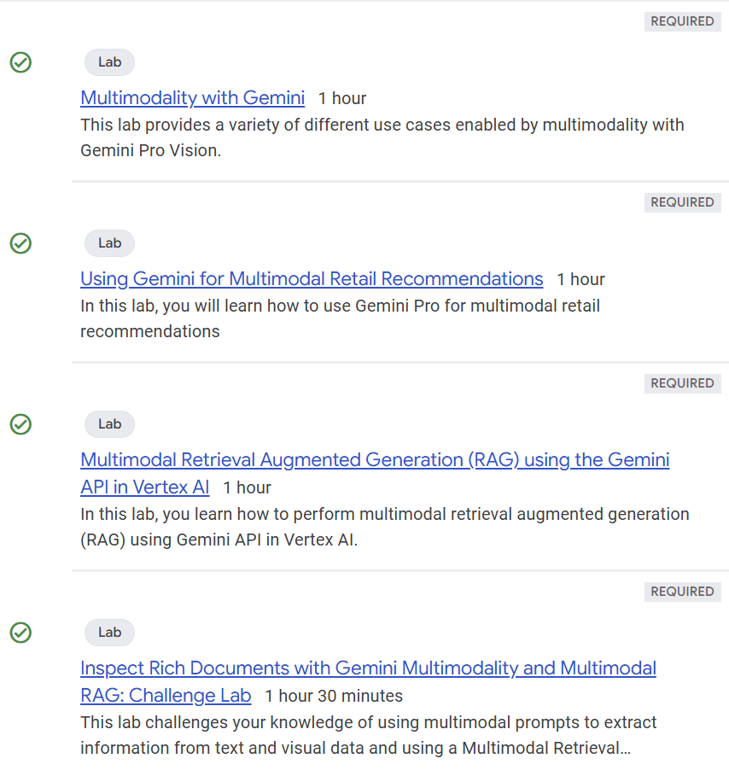

Slide 3
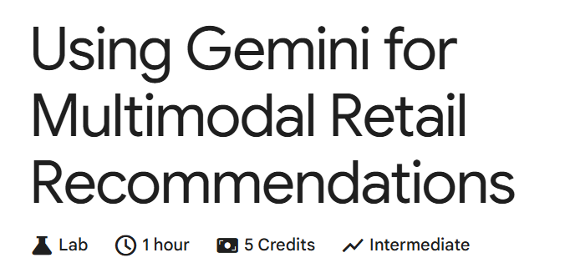
Notes:
https://www.cloudskillsboost.google/course_templates/981/labs/514648

Slide 4
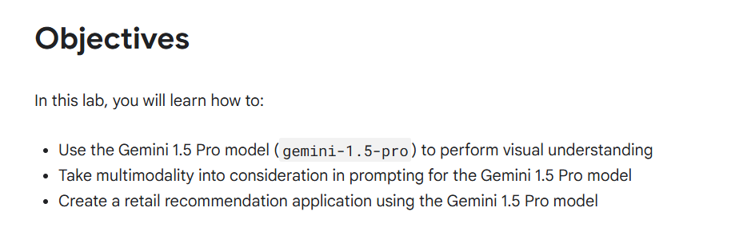

Slide 5


